Slide 1

Customer Shopping Behavior Analysis
Uncovering insights from 3,900 purchases to guide strategic business decisions

Slide 2

Dataset Overview
3,900 Purchases
18 Features
Transactions analyzed across multiple categories
Demographics, purchase details, behavior patterns
37 Missing Values
Review ratings imputed by category median

Slide 3

Customer Demographics
44
50
$60
Average Age
Locations
Avg Purchase
Range: 18–70 years
Geographic diversity across regions
Mean transaction value

Slide 4

Revenue Insights
By Gender
By Age Group
Male: $157,890
Young Adult: $62,143
Female: $75,191
Middle-aged: $59,197
Adult: $55,978

Slide 5
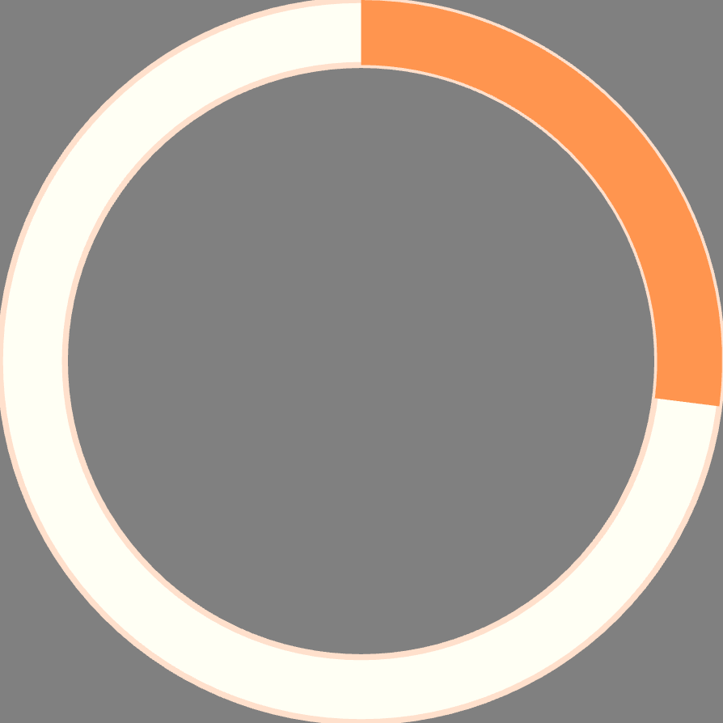

Subscription Impact
27%
73%
Subscribers
Non-Subscribers
1,053 customers with subscriptions
2,847 customers without subscriptions
Key Finding: Subscribers avg $59.49 vs. non-subscribers $59.87—opportunity to increase subscription value.

Slide 6

Customer Segmentation
Loyal
Returning
3,116 customers
701 customers
New
83 customers
80% of customers are loyal repeat buyers—focus on retention and upselling.

Slide 7

Product Performance
1
2
3
Top Rated
Discount Dependent
Best Sellers
Gloves (3.86), Sandals (3.84), Boots (3.82)
Hat (50%), Sneakers (49.7%), Coat (49.1%)
Blouse, Pants, Shirt in Clothing; Jewelry in Accessories

Slide 8

Discount & Shipping Patterns
Discount Users
Shipping Preference
839 high-spending customers used discounts while spending above average
Express: $60.48 avg
Standard: $58.46 avg

Slide 9
Strategic Recommendations
1
Boost Subscriptions
2
Loyalty Programs
Promote exclusive benefits to increase subscriber value
Reward repeat buyers to strengthen retention
3
Optimize Discounts
4
Targeted Marketing
Balance sales growth with margin control
Focus on high-revenue segments and express-shipping users

